Slide 1

Brute Force String Matching
By Ahmed Abdulrazzaq

Slide 2
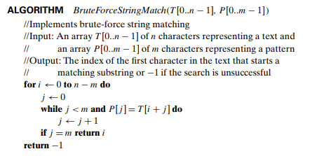
Brute Force String Matching
Pseudocode

Slide 3
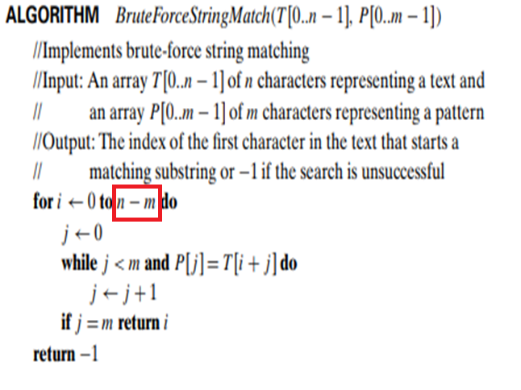
If we have a text with 100 characters and the pattern, we specified is 50 characters, there is no point to loop for 100 characters
100 - 50 = 50 => (n - m)
The algorithm will iterate for one more character after 50 to check if 51 is a match. If so, it will keep iterating.
if not 49 != 50 no match in this case.

Slide 4
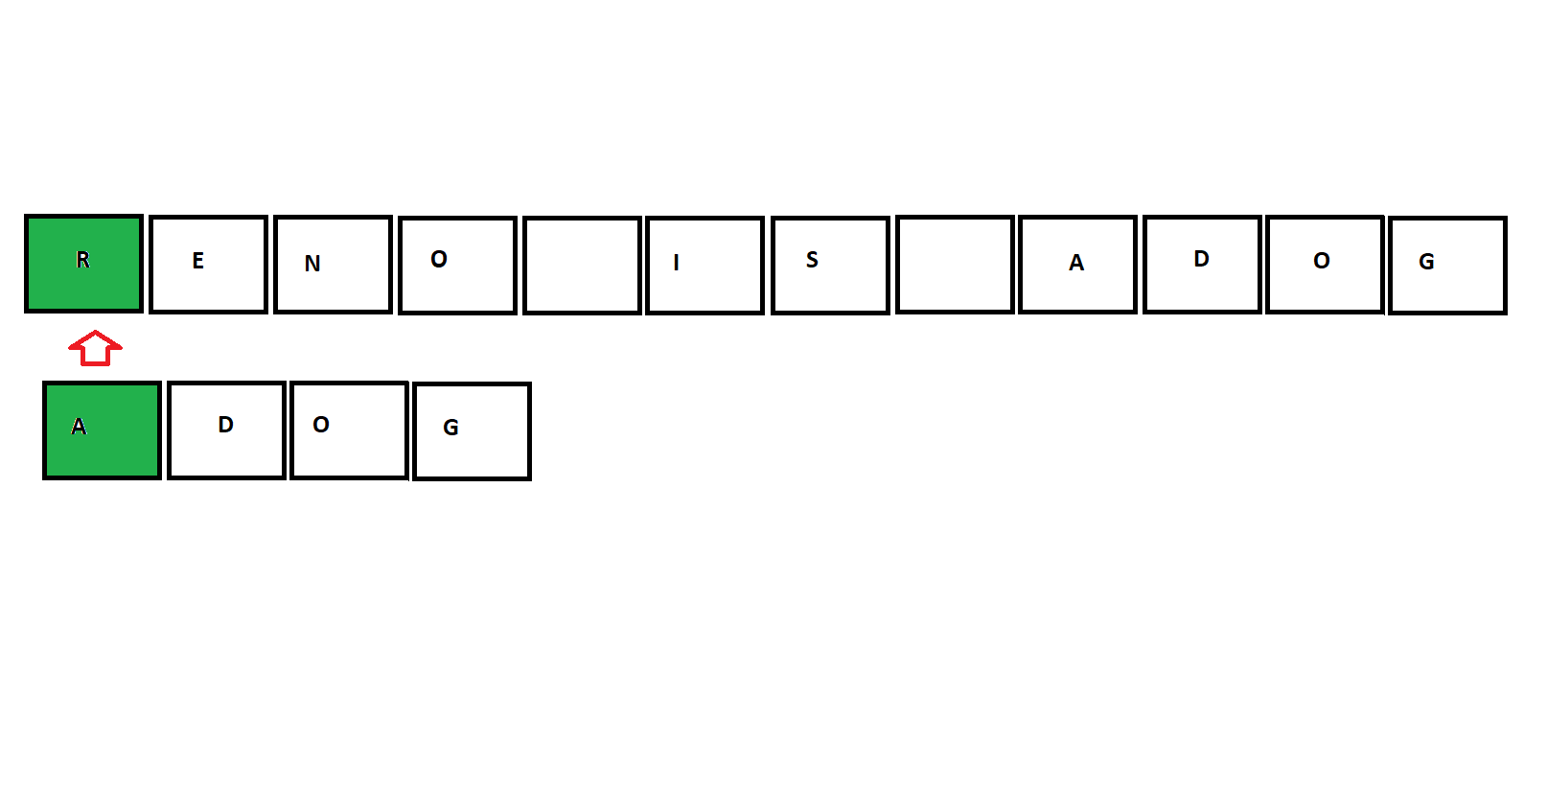

Slide 5
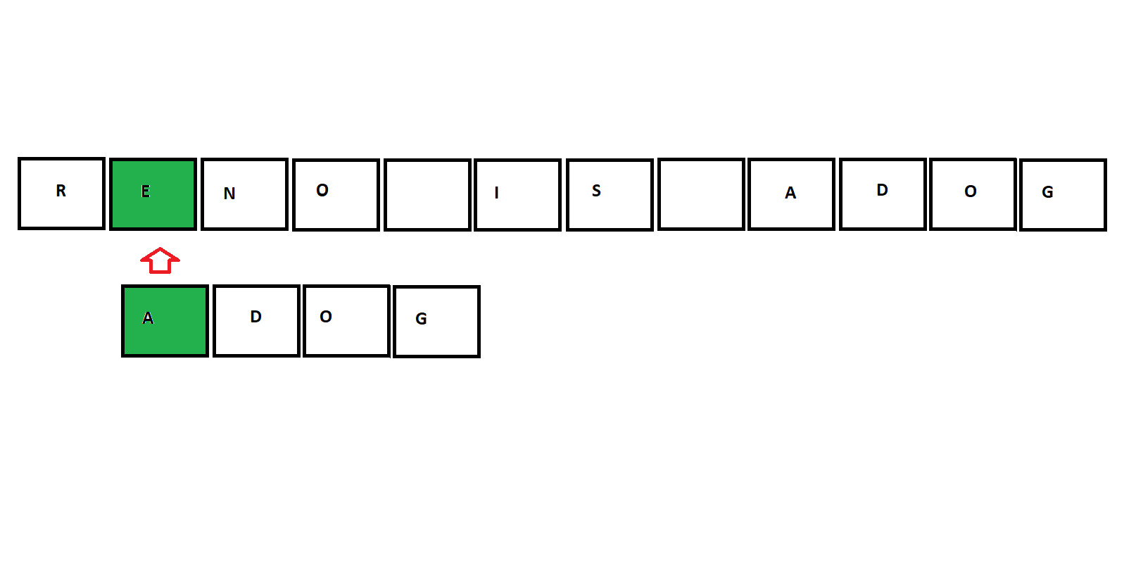
1
2
3
4
5
6

Slide 6
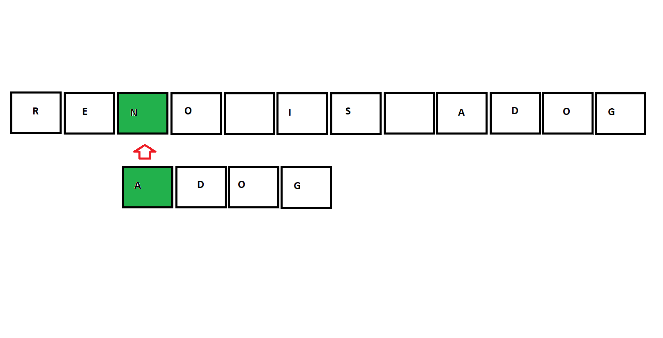

Slide 7
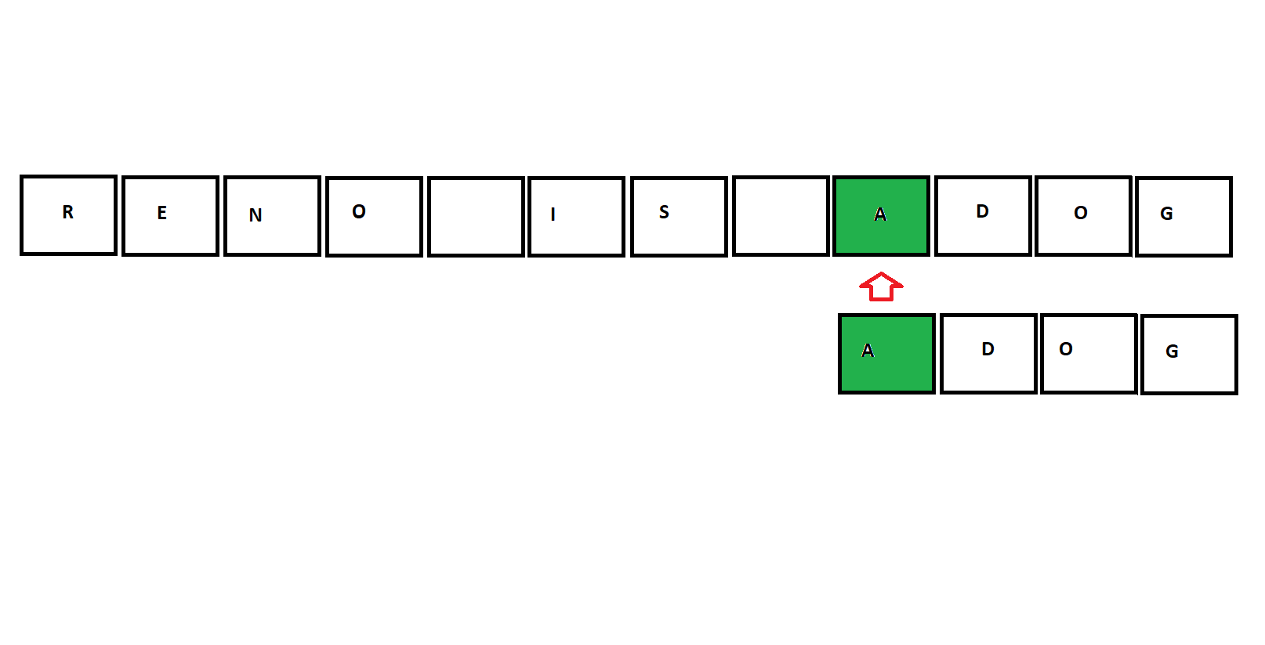

Slide 8
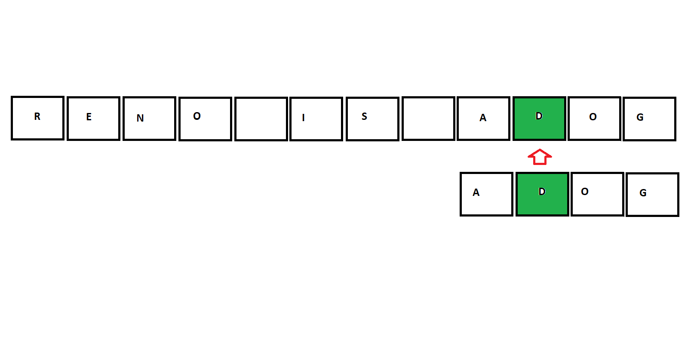

Slide 9
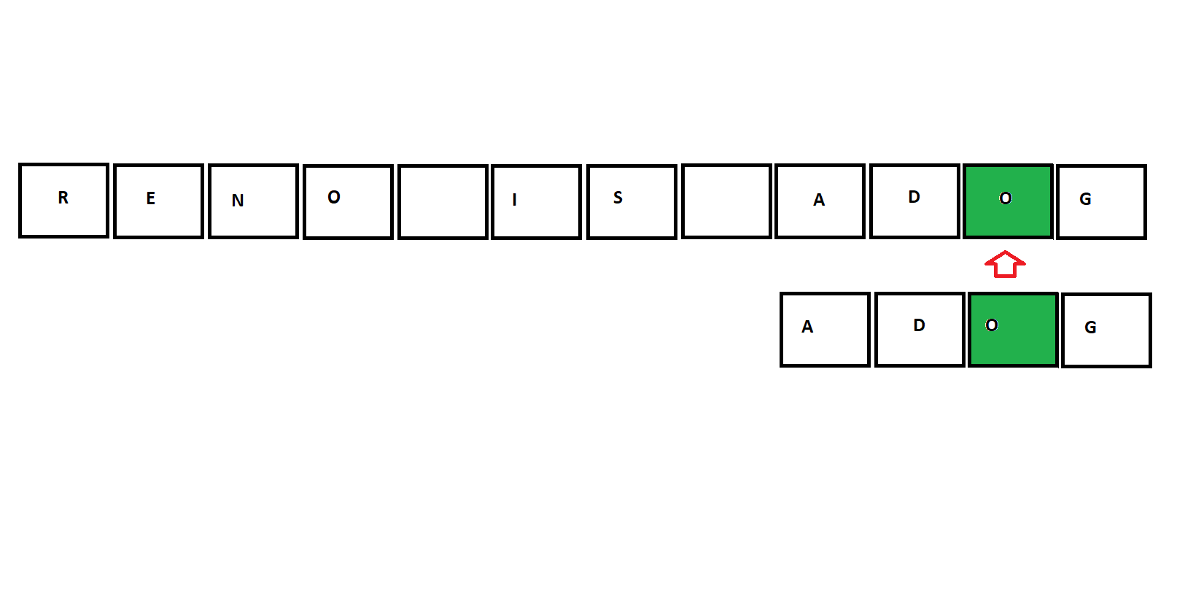

Slide 10
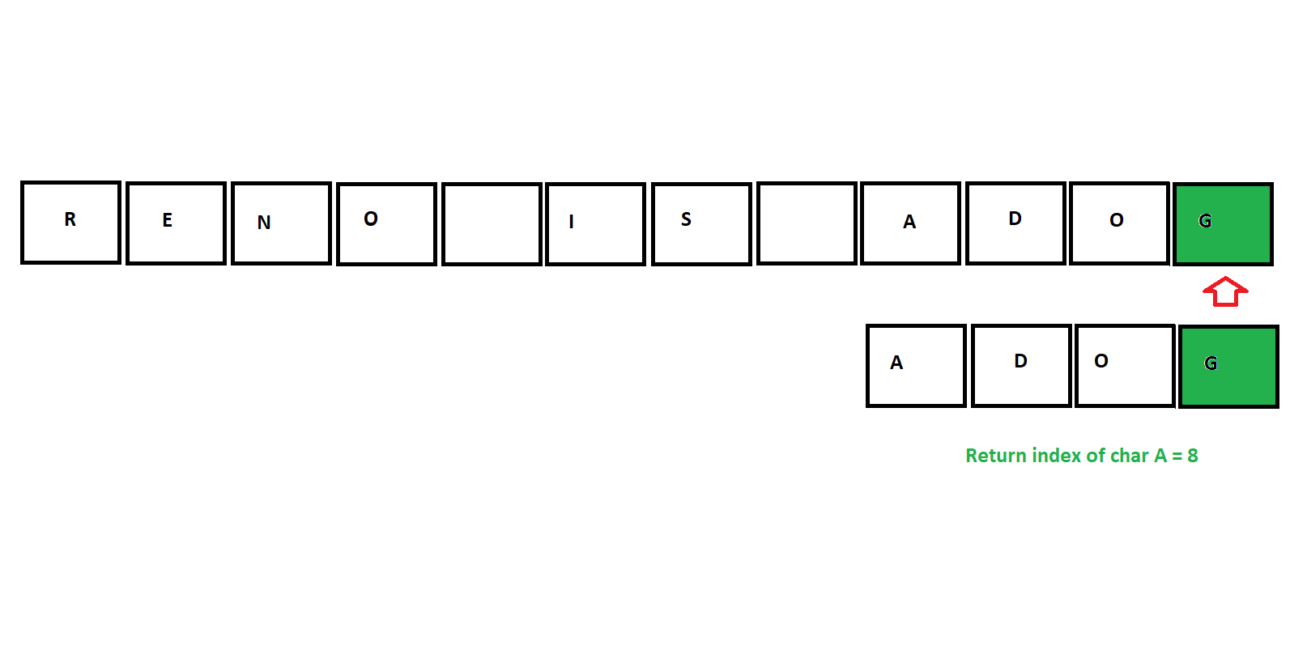

Slide 11
